Slide 1

Data Literacy

Slide 2
Definition
“Data literacy is the ability to read, understand, create, and communicate data as information. Much like literacy as a general concept, data literacy focuses on the competencies involved in working with data.”
https://en.wikipedia.org/wiki/Data_literacy

Slide 3
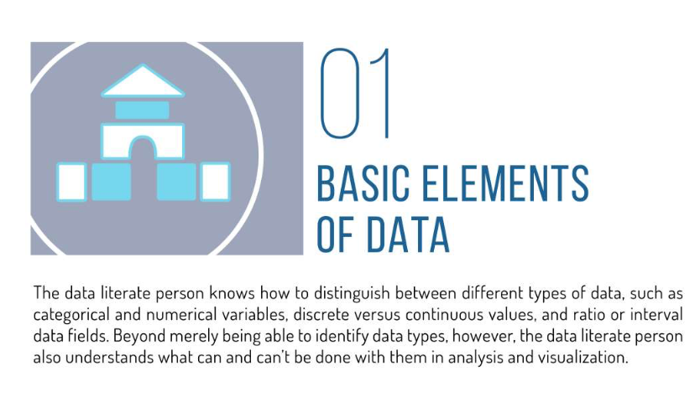
https://www.slideshare.net/dataremixed/17-key-traits-of-data-literacy

Slide 5
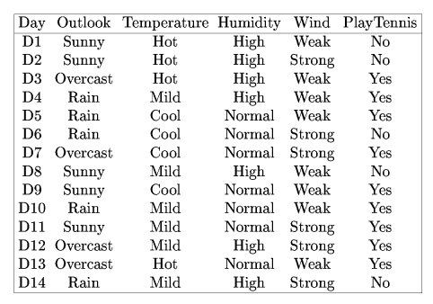
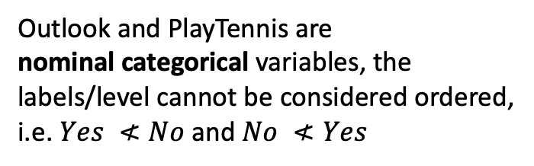
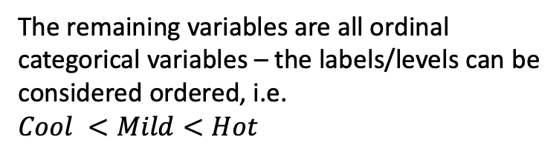
Variables
All of the variables in this data set are categorical variables – variables whose values only consist of labels/levels.
Outlook and PlayTennis are nominal categorical variables, the labels/level cannot be considered ordered, i.e. $Yes ≮No$ and $No ≮Yes$
The remaining variables are all ordinal categorical variables – the labels/levels can be considered ordered, i.e. $Cool <Mild<Hot$

Slide 6
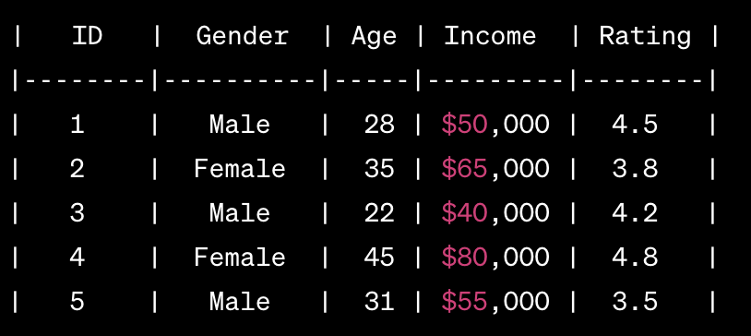
ID: Discrete numerical variable representing a unique identifier for each individual.
Gender: Nominal categorical variable representing the gender of the individual (Male/Female).
Age: Discrete numerical variable representing the age of the individual.
Income: Continuous numerical variable representing the income of the individual.
Rating: Continuous numerical variable representing a rating given by the individual.
Note: We see later that we will treat numerical ID variables like they appear in this table as nominal categorical variables because it makes no sense to use these identifiers as numerical values, we cannot order them or do mathematical transformations on them.

Slide 7
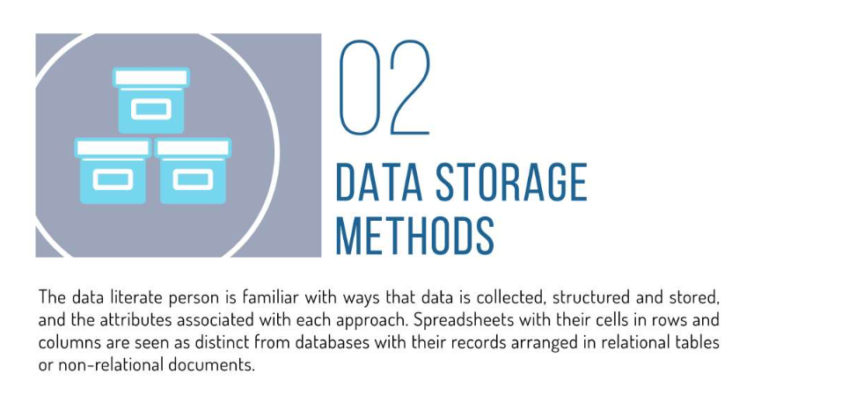

Slide 8
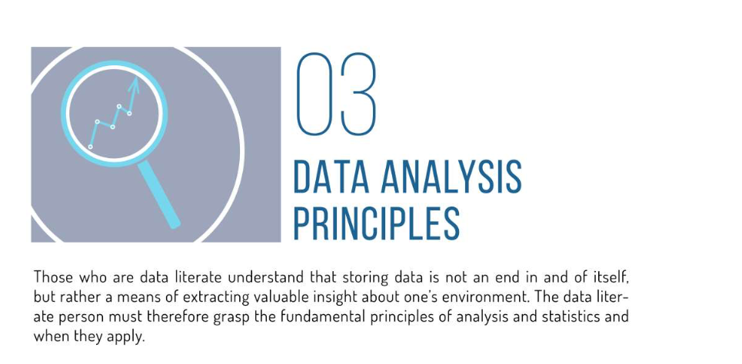

Slide 9
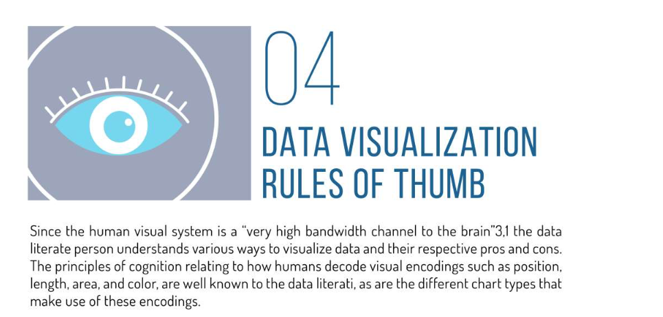
,
,
http://www.cs.ubc.ca/labs/imager/tr/2009/VisChapter/akp-vischapter.pdf

Slide 10
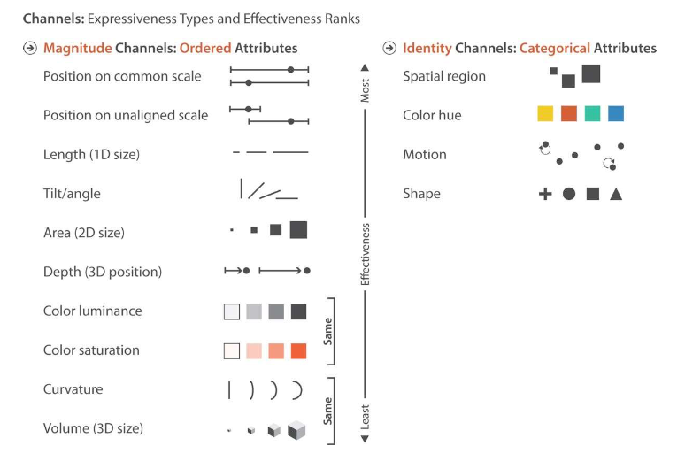

Slide 11
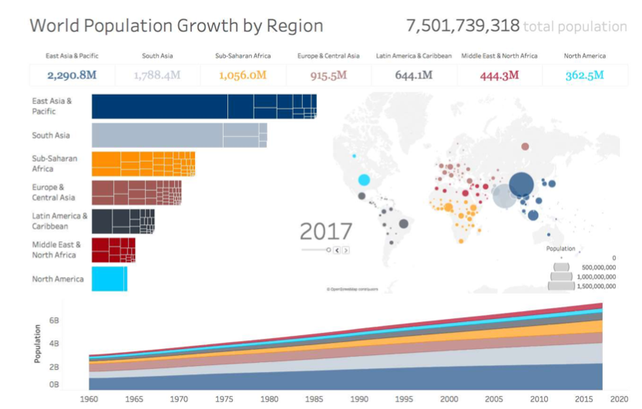
https://data.worldbank.org/indicator/SP.POP.TOTL

Slide 12
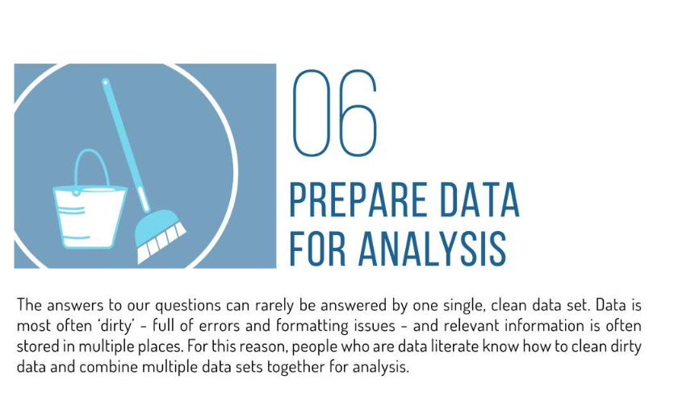

Slide 13
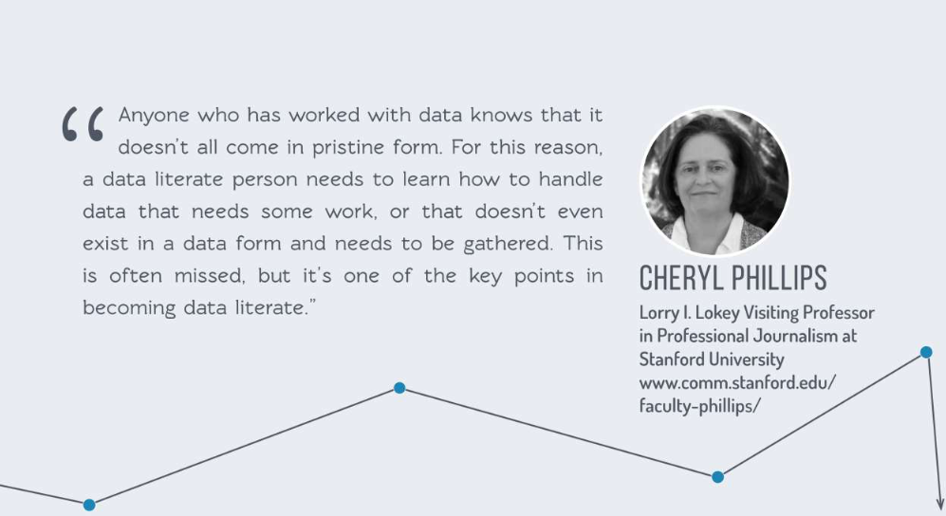

Slide 14
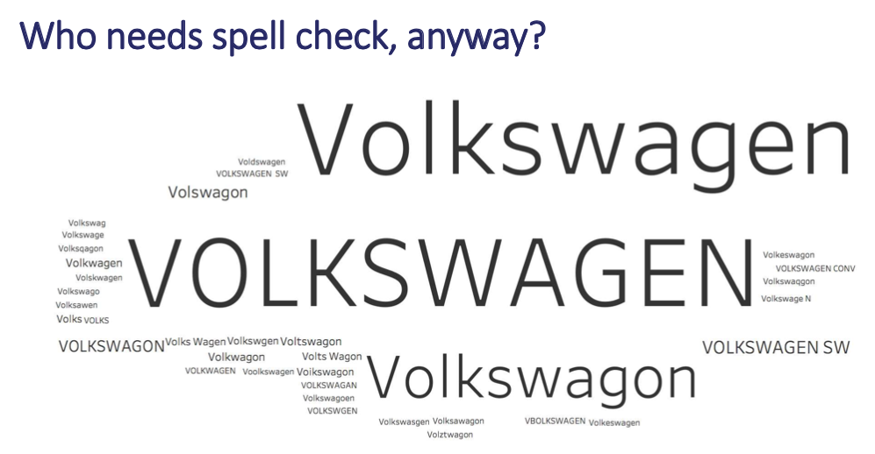

Slide 15
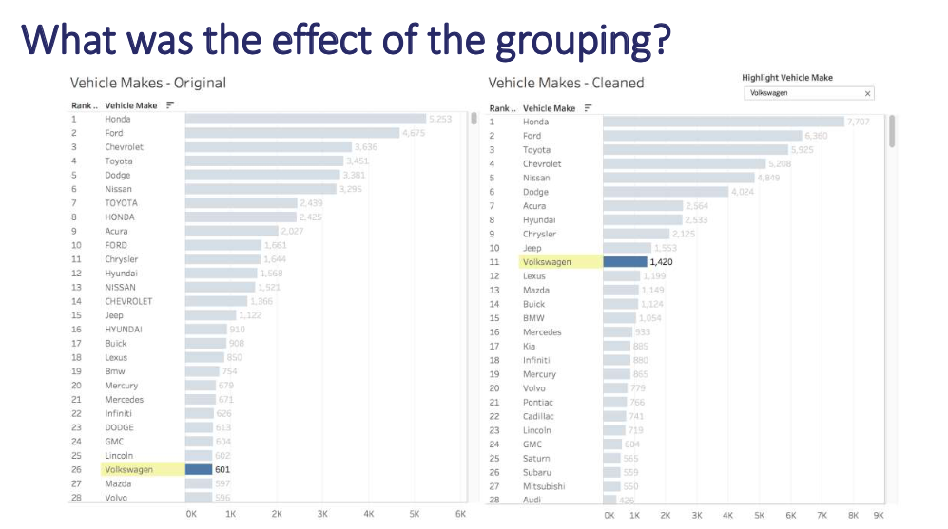

Slide 16
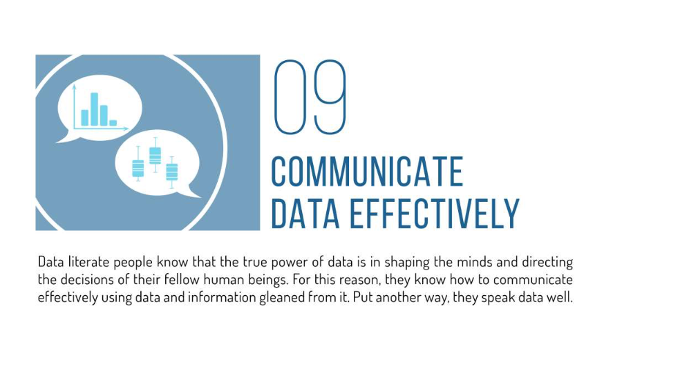

Slide 17
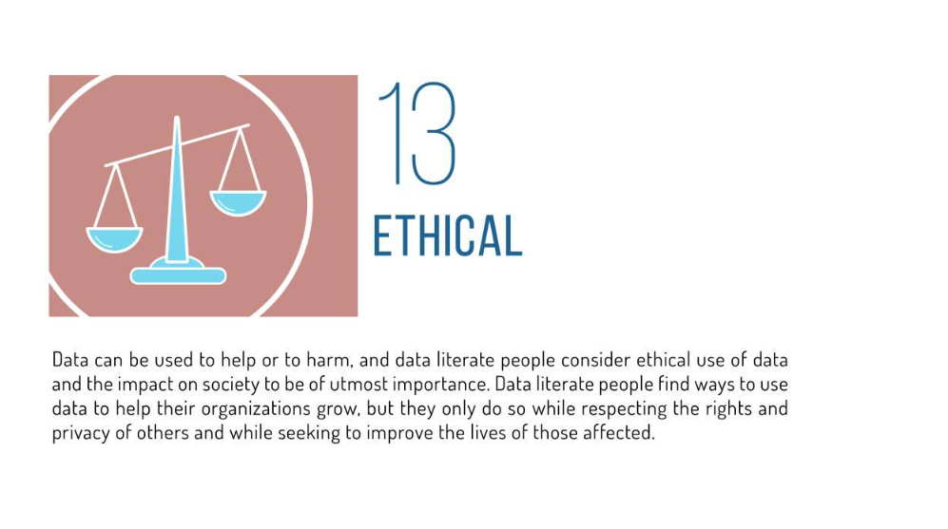

Slide 18
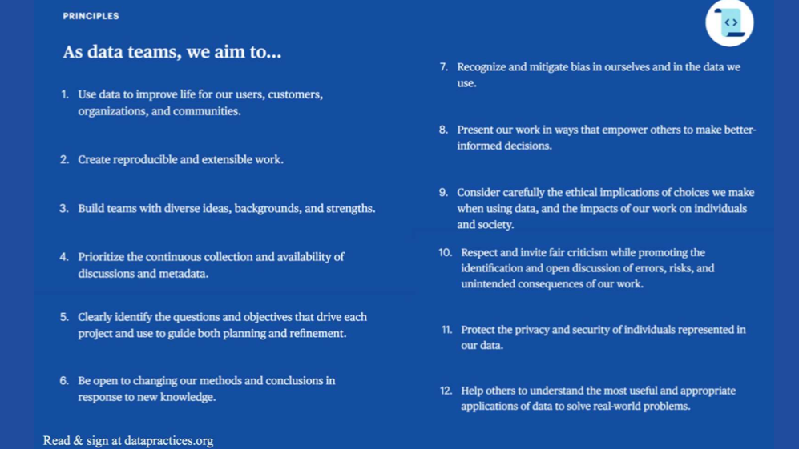
Source: https://datapractices.org

Slide 19
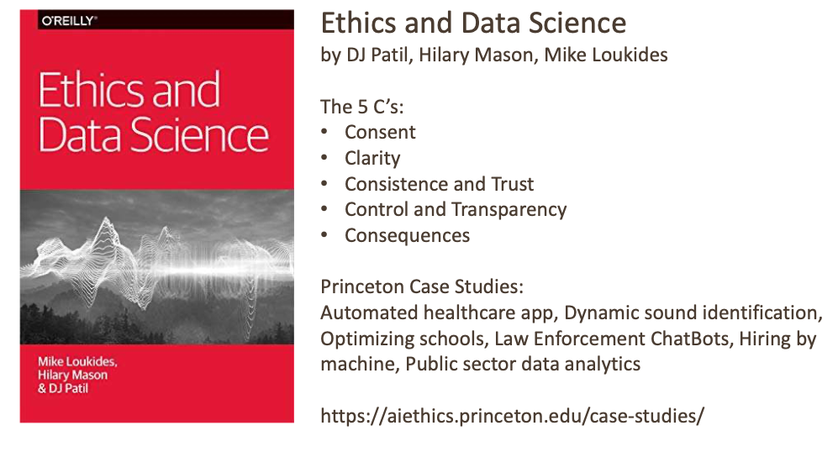
https://aiethics.princeton.edu/case-studies/

Slide 20
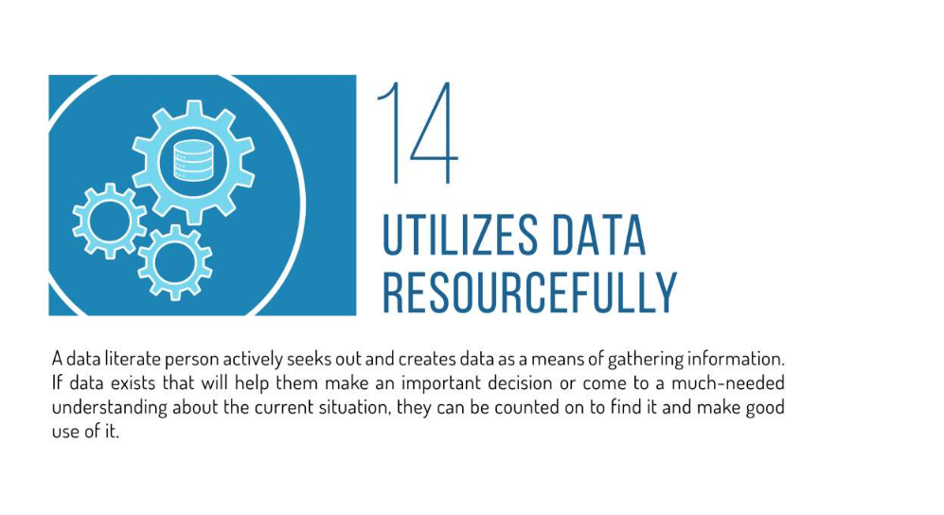

Slide 21
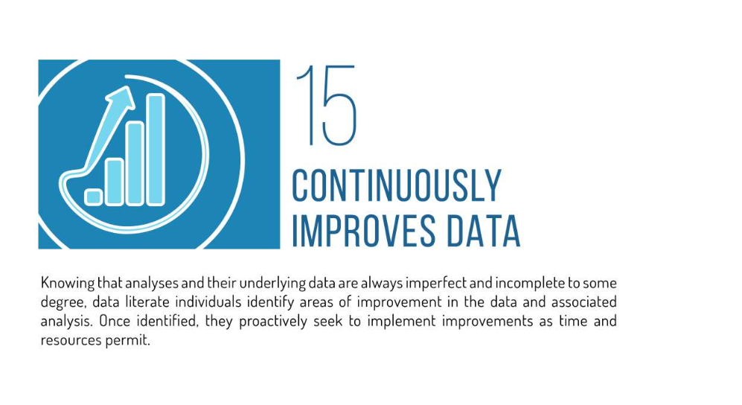

Slide 22
